Slide 1
Architecting Digital Twins
Expert interviews
Anonymised

Slide 2
Digital Twin

Slide 3
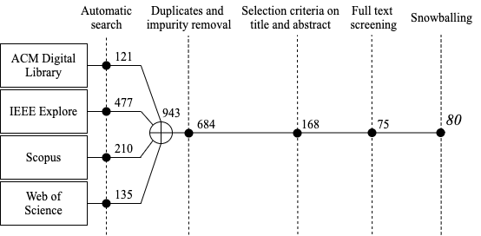
Research Goal(RG) and Questions (RQx)
RG: Identify, classify and analyse digital twin architectural solutions.
RQ1: Which are the publication trends for DT architectural solutions?
RQ2: Which are the quality attributes for DT?
RQ3: Which are the architectural solutions for DT?
RQ4: Which is the catalogue of architectural patterns for DT?

Slide 4
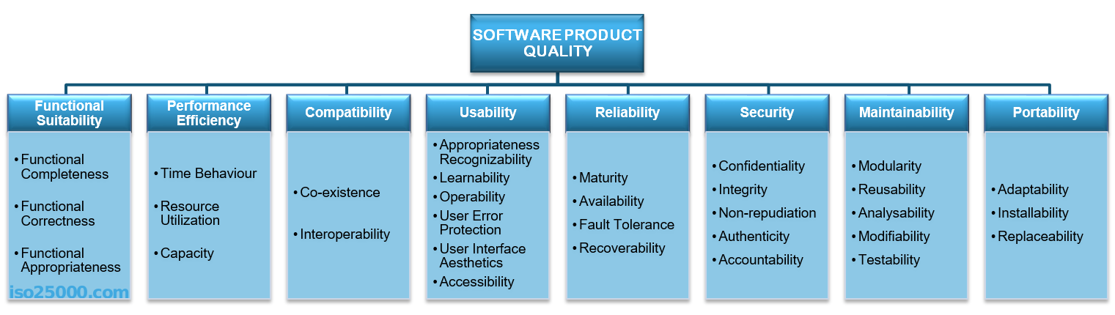
RQ2 - Quality attributes (ISO 25010)

Slide 5
RQ3 - Architectural solutions
Architectural pattern : Description of elements and relation types together with a set of constraints on how they may be used.
Reference model: Division of functionality together with data flow between the pieces
Reference architecture: Reference model mapped onto software components
Software architecture: Structure of structures of a system which comprise software elements, the externally visible properties of those elements , and relationships among them.

Slide 6
Interview procedure
SMS results.
Questions on the collected data.
Expert remarks, comments and reflections.

Slide 7
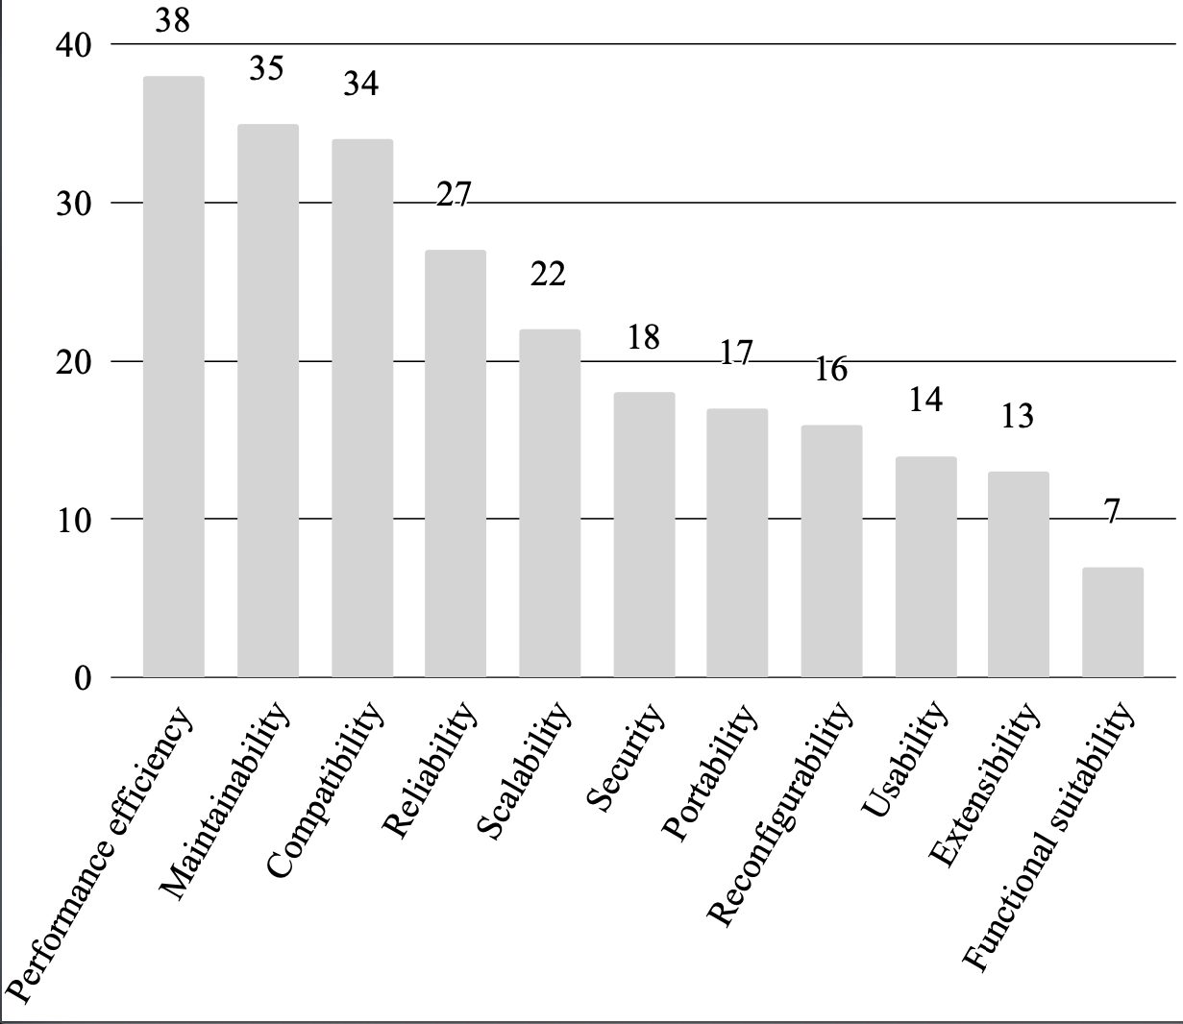
Quality attributes for DT
Do you see any missing QA or property that you thought could be important?
Three QA not explicitly mentioned in the standard.
Can these attributes be clustered into any of the predefined categories in the standard?

Slide 8
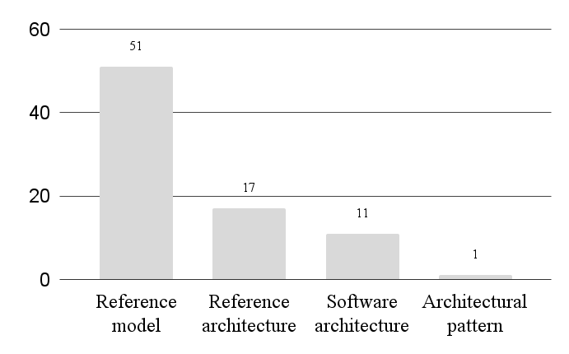
Architectural solutions for DT
More than 60% of papers propose Reference Models. How do you interpret the result?
Does this impact industry and academia collaboration?
What are the steps that researchers and practitioners have to overcome to transition from a reference model to a reference architecture or a complete software architecture?

Slide 9
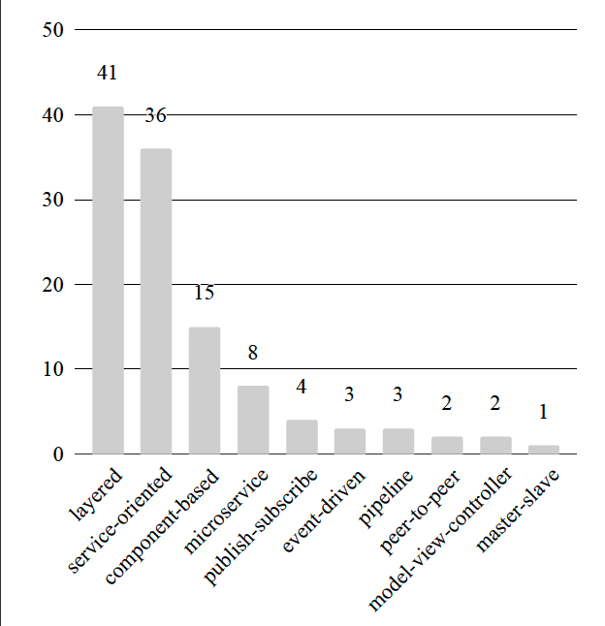
Architectural patterns
Why do you think that layered is the most rated (its the most known vs. It tackles better the complexity, etc.)?
Why is in your opinion there a difference in count between service oriented and micro-services?

Slide 10
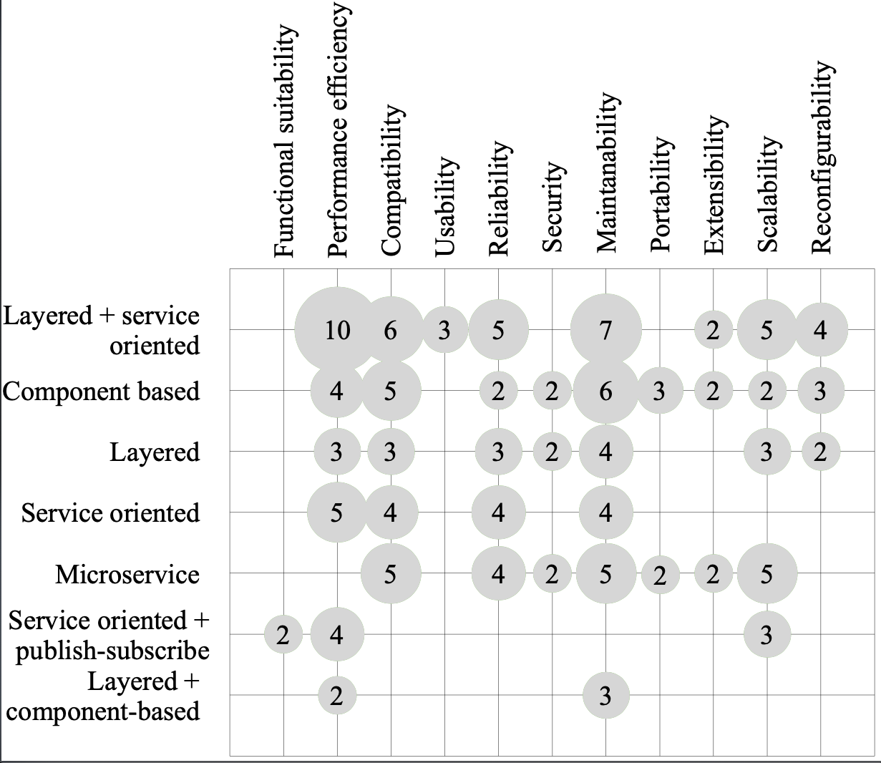
QA vs Patterns
Based on your experience do you find any of these relations unusual?
Did you expect a higher concentration of results in any of the relations between QA and Patterns?

Slide 11
Thank you for your time!

